Slide 1
BootStrap Unit-5 Part3

Slide 2
Icons:Bootstrap Glyphicon Components
<!DOCTYPE html> <html> <head> <meta name="viewport" content="width=device-width, initial-scale=1"> <link rel="stylesheet" href="https://maxcdn.bootstrapcdn.com/bootstrap/3.4.0/css/bootstrap.min.css"> <script src="https://ajax.googleapis.com/ajax/libs/jquery/3.6.4/jquery.min.js"></script> <script src="https://maxcdn.bootstrapcdn.com/bootstrap/3.4.0/js/bootstrap.min.js"></script> </head> <body> <div class="container"> <h2>Glyphicon Examples</h2> <p>Envelope icon: <span class="glyphicon glyphicon-envelope"></span></p> <p>Envelope icon as a link: <a href="#"> <span class="glyphicon glyphicon-envelope"></span> </a> </p> | <p>Search icon: <span class="glyphicon glyphicon-search"></span></p> <p>Search icon on a button: <button type="button" class="btn btn-default"> <span class="glyphicon glyphicon-search"></span> Search </button> </p> <p>Search icon on a styled button: <button type="button" class="btn btn-info"> <span class="glyphicon glyphicon-search"></span> Search </button> </p> <p>Print icon: <span class="glyphicon glyphicon-print"></span></p> <p>Print icon on a styled link button: <a href="#" class="btn btn-success btn-lg"> <span class="glyphicon glyphicon-print"></span> Print </a> </p> </div> </body> </html>

Slide 3
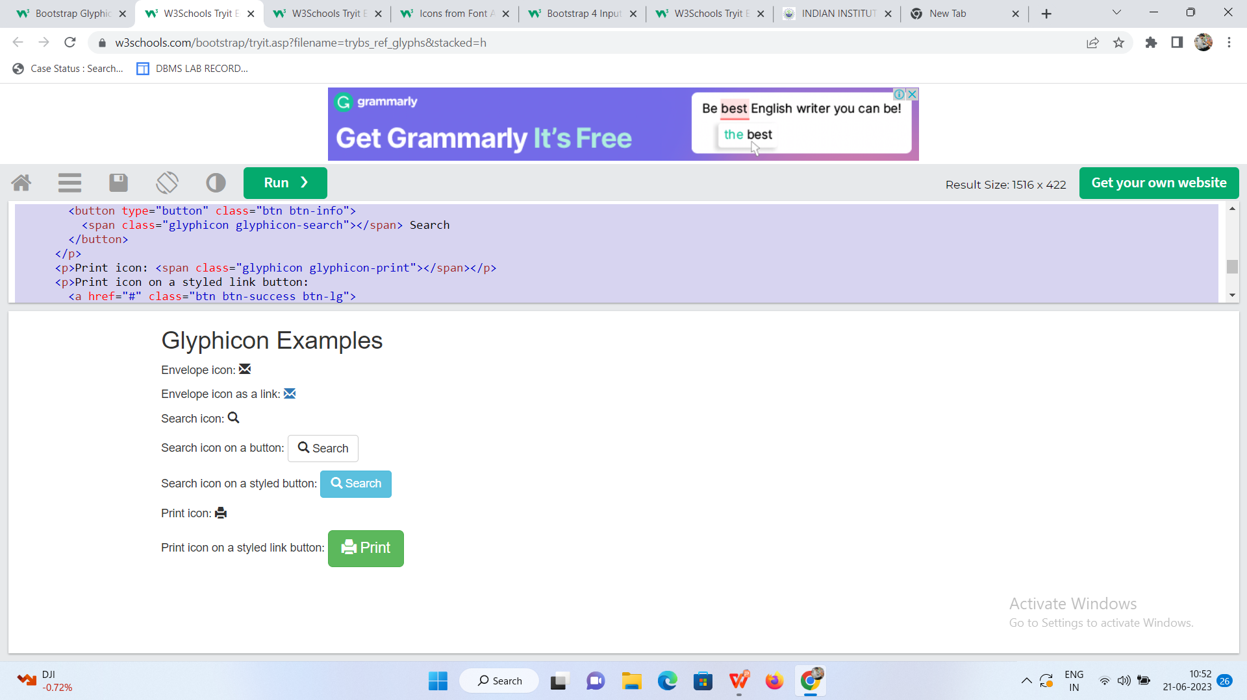

Slide 4
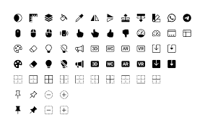

Slide 5
Bootstrap Form Inputs
Bootstrap supports the following form controls:
input
textarea
checkbox
radio
select
Bootstrap Input:
Bootstrap supports all the HTML5 input types: text, password, datetime, datetime-local, date, month, time, week, number, email, url, search, tel, and color.

Slide 6
<!DOCTYPE html>
<html lang="en">
<head>
<title>Bootstrap Example</title>
<meta charset="utf-8">
<meta name="viewport" content="width=device-width, initial-scale=1">
<link rel="stylesheet" href="https://maxcdn.bootstrapcdn.com/bootstrap/3.4.1/css/bootstrap.min.css">
<script src="https://ajax.googleapis.com/ajax/libs/jquery/3.6.4/jquery.min.js"></script>
<script src="https://maxcdn.bootstrapcdn.com/bootstrap/3.4.1/js/bootstrap.min.js"></script>
</head>
<body>
<div class="container">
<h2>Form control: input</h2>
<p>The form below contains two input elements; one of type text and one of type password:</p>
<form>
<div class="form-group">
<label for="usr">Name:</label>
<input type="text" class="form-control" id="usr">
</div>
<div class="form-group">
<label for="pwd">Password:</label>
<input type="password" class="form-control" id="pwd">
</div>
</form>
</div>
</body>
</html>

Slide 7
Form control: input
The form below contains two input elements; one of type text and one of type password:
Name:
Password:

Slide 8
Bootstrap Textarea
<!DOCTYPE html>
<html lang="en">
<head>
<title>Bootstrap Example</title>
<meta charset="utf-8">
<meta name="viewport" content="width=device-width, initial-scale=1">
<link rel="stylesheet" href="https://maxcdn.bootstrapcdn.com/bootstrap/3.4.1/css/bootstrap.min.css">
<script src="https://ajax.googleapis.com/ajax/libs/jquery/3.6.4/jquery.min.js"></script>
<script src="https://maxcdn.bootstrapcdn.com/bootstrap/3.4.1/js/bootstrap.min.js"></script>
</head>
<body>
<div class="container">
<h2>Form control: textarea</h2>
<p>The form below contains a textarea for comments:</p>
<form>
<div class="form-group">
<label for="comment">Comment:</label>
<textarea class="form-control" rows="5" id="comment"></textarea>
</div>
</form>
</div>
</body>
</html>

Slide 9
Form control: textarea
The form below contains a textarea for comments:
Comment:

